Slide 1

Increasing performance in D3

Slide 2
Basic strategies
Minimize number of XML elements
Use d3.timer for animation
Update selectively
Fetch data incrementally
Use the profiler/timeline tools

Slide 3
Minimizing elements

Slide 4
Minimizing elements

Slide 5
Strategies
Simple: remove non-essentials

Slide 6
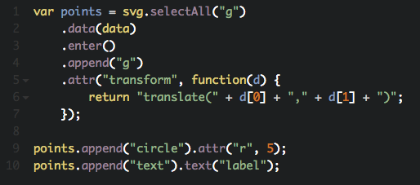
Remove non-essentials

Slide 7
Strategies
Simple: remove non-essentials
Use canvas backend

Slide 8
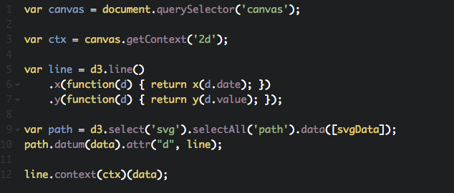
Use canvas backend

Slide 9
Strategies
Remove non-essentials
Use canvas backend
Filter data

Slide 10
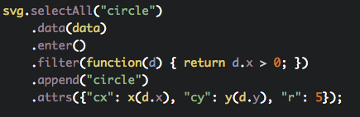
Filter data

Slide 11
Strategies
Remove non-essentials
Use canvas backend
Filter data
Use paths instead of many elements

Slide 12
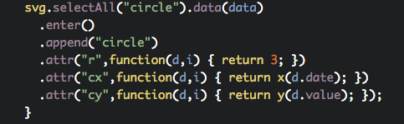
Using paths

Slide 13
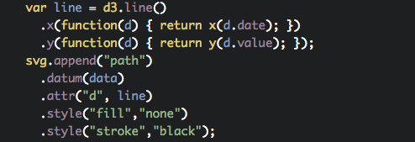
Using paths

Slide 14
Using d3-timer

Slide 15
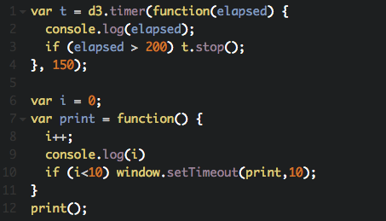
Using d3-timer

Slide 16
Update pattern

Slide 17
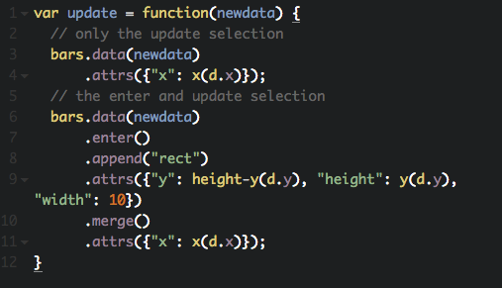
Using update pattern

Slide 18
Time line debugging

Slide 19
Using timeline
Inside web inspector, open time line tab

Slide 20
Using timeline
Inside web inspector, open time line tab
Refresh to save data

Slide 21
Using timeline
Inside web inspector, open time line tab
Refresh to save data
Use event log to search for function call

Slide 22
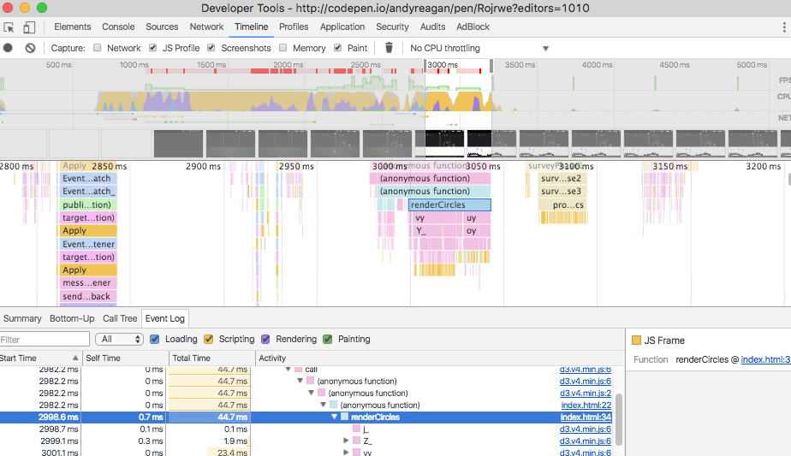
Using timeline

Slide 23
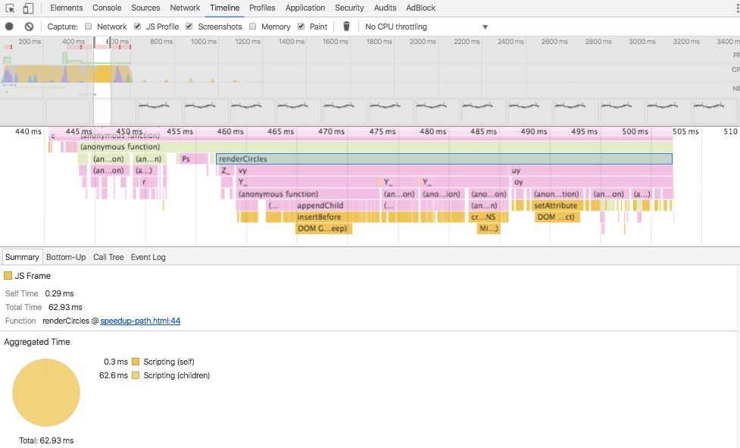
Using timeline

Slide 24


